Slide 1
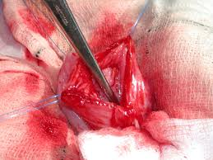
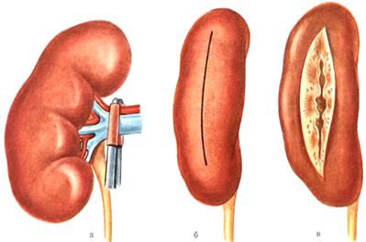
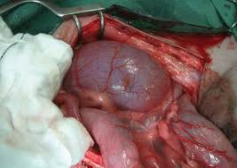
Nephrotomy

Slide 2
Nephrotomy
Nephrotomy usually is performed to remove calculi lodged in the renal pelvis. Make a sharp incision along the capsule of the convex border of the kidney, and bluntly dissect the renal parenchyma to the renal pelvis. Remove the calculi and close the nephrotomy by apposing the cut tissue and suturing the capsule in a continuous pattern with absorbable suture material. If adequate hemostasis is not achieved, or if urine leakage is a concern, place absorbable sutures through the cortex in a horizontal mattress fashion. Then suture the capsule in a continuous pattern with absorbable suture material.

Slide 3
Nephrectomy
Nephrectomy is excision of the kidney.
Indicated of nephrectomy
1-renal neoplasia
2-uncontrollable hemorrhage
3-persistent urine leakage
4-hydronephrosis
5-pyelonephritis resistant to medical therapy
6-ureter abnormalities that surgical repair (e.g., avulsion, stricture, rupture).

Slide 4
Nephrectomy
● Technique
1- Grasp the peritoneum over the kidney and incise it. Using a combination of blunt and sharp dissection, free the kidney from its sublumbar attachments.
2- Elevate the kidney and retract it medially to locate the renal artery and vein on the dorsal surface of the renal hilus .
3- Identify all branches of the renal artery. Double ligate the renal artery with absorbable suture (e.g., polydioxanone, polyglyconate, poliglecaprone 25)

Slide 5
Nephrotomy
4- ensure that all branches have been ligated. Identify the renal vein and ligate it similarly.
5- Avoid ligating the renal artery and vein together to prevent the formation of an arteriovenous fistula.
6- Ligate the ureter near the bladder. Remove the kidney and ureter

